Slide 1


RAJALAKSHMI ENGINEERING COLLEGE
DEPARTMENT OF MECHATRONICS ENGINEERING
DESIGN AND FABRICATION OF HAPTIC CONTROLLER MODULE FOR TELEOPERATION OF ROBOTS
Batch - 13
Project Work Phase-2
SUPERVISOR :
Mr. M. SHANMUGAM
(Assistant Professor)
PRESENTED BY :
NARESH KUMAR O (191201028)
SRIVATSAN S (191201047)
SUBIN S (191201048)

Slide 2
PROBLEM STATEMENT
Existing techniques relies on visual feedback allow only limited control of the robotic arm whilst providing non-optimal feedback of the same.
Furthermore, non-intuitive control such as joysticks and keyboards cannot provide a measure of control nor perception in varied applications through visual feedback.
Hence, the need arises for other potential methods that can be implemented to provide greater sense of control and feedback to the operator.

Slide 3
ABSTRACT
The current control modules used in robotic teleoperation don’t offer enough precision and accuracy in moving a robotic part.
The problem with the current teleoperation control modules is that it completely relies on the visual feedback of the module. It is not enough for a controller to make minute operations from a long distance.
The proposed system works based on the haptic force-feedback mechanism to achieve the above-mentioned teleoperation module.
This can help us control and train the robots more effectively and efficiently.
It offers us the most precise solution for controlling the robots set at a distance.

Slide 4
NOVELTY
The incorporation of haptics in teleoperation can prove to be more efficient in industries such as medicine, automotive, chemical etc, where there is a need for human supervision for the handling of volatile operations.
The product can support small scale industries as an alternative to full scale automation.
The product is a cost effective without compromise in quality as well as its functionality.

Slide 5
OBJECTIVE
To design and fabricate haptic feedback glove which can be used for teleoperation of robotics arm for pick and place operations in industries
The haptic controller module built can help us overcome the most important disadvantages of robotic teleoperation systems, which is only relying on the visual feedback provided by the module.
The force feedback using the haptic mechanism can help us control and train the robots more effectively and efficiently.
It offers us the most precise solution for controlling the robots set at a distance.

Slide 6

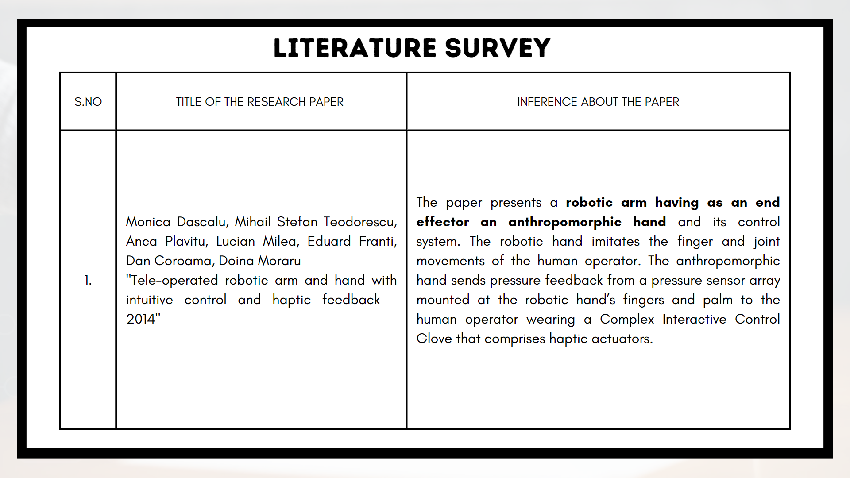
Literature survey
S.NO
1.
TITLE OF THE RESEARCH PAPER
Monica Dascalu, Mihail Stefan Teodorescu, Anca Plavitu, Lucian Milea, Eduard Franti,
Dan Coroama, Doina Moraru
"Tele-operated robotic arm and hand with intuitive control and haptic feedback - 2014"
INFERENCE ABOUT THE PAPER
The paper presents a robotic arm having as an end effector an anthropomorphic hand and its control system. The robotic hand imitates the finger and joint movements of the human operator. The anthropomorphic hand sends pressure feedback from a pressure sensor array mounted at the robotic hand’s fingers and palm to the human operator wearing a Complex Interactive Control Glove that comprises haptic actuators.

Slide 7
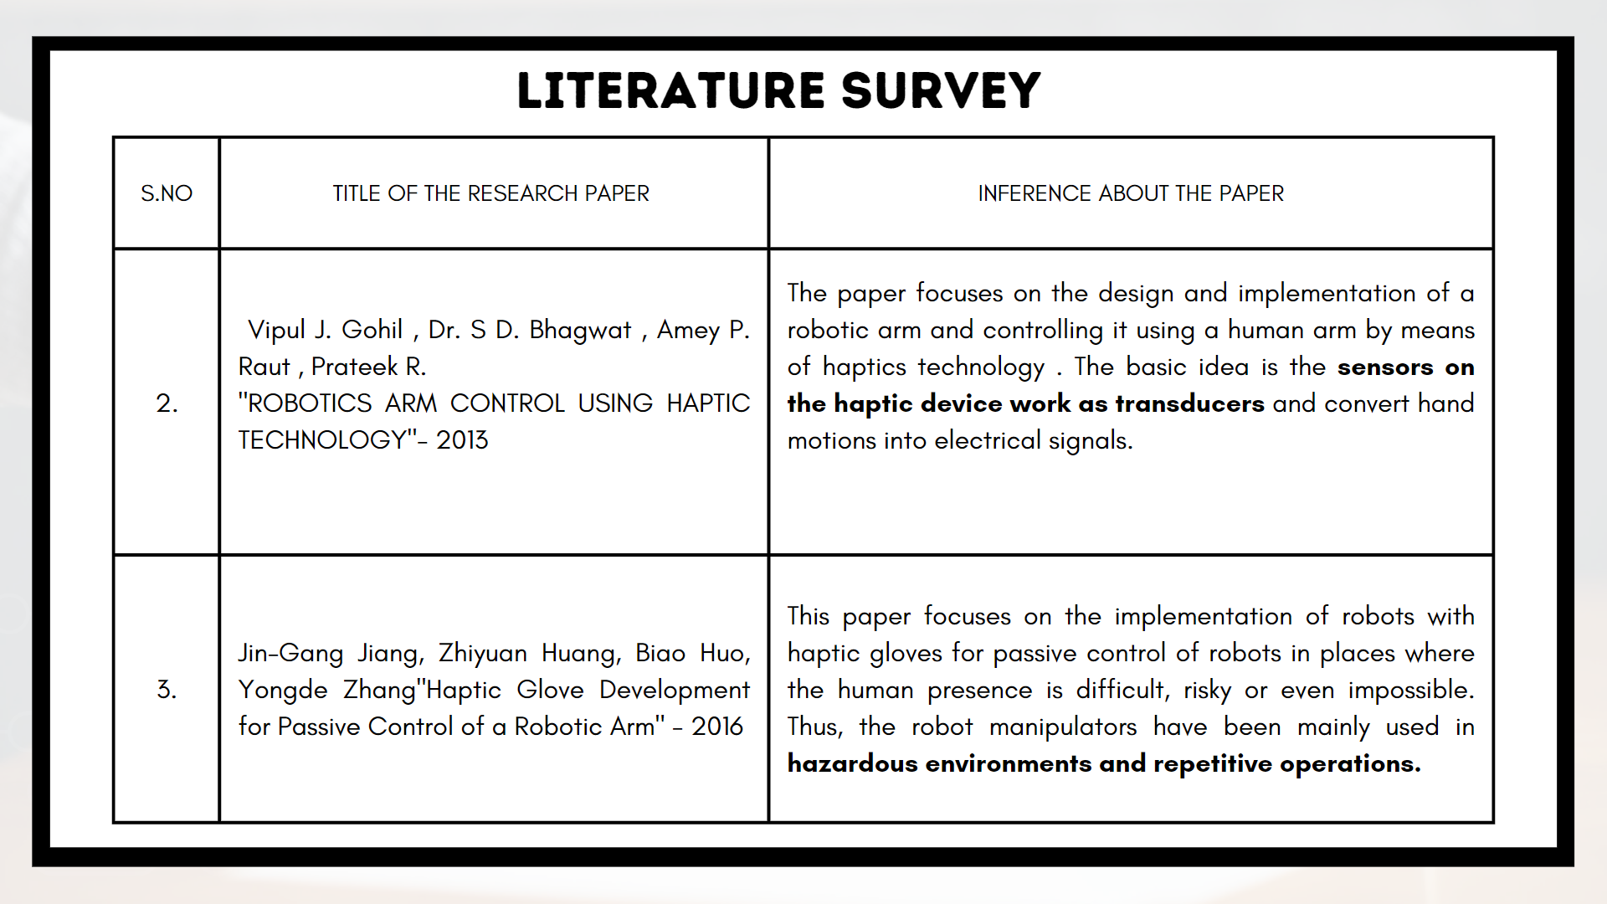
Literature survey
S.NO
2.
3.
TITLE OF THE RESEARCH PAPER
Vipul J. Gohil , Dr. S D. Bhagwat , Amey P. Raut , Prateek R.
"ROBOTICS ARM CONTROL USING HAPTIC TECHNOLOGY"- 2013
Jin-Gang Jiang, Zhiyuan Huang, Biao Huo, Yongde Zhang"Haptic Glove Development for Passive Control of a Robotic Arm" - 2016
INFERENCE ABOUT THE PAPER
The paper focuses on the design and implementation of a robotic arm and controlling it using a human arm by means of haptics technology . The basic idea is the sensors on the haptic device work as transducers and convert hand motions into electrical signals.
This paper focuses on the implementation of robots with haptic gloves for passive control of robots in places where the human presence is difficult, risky or even impossible. Thus, the robot manipulators have been mainly used in hazardous environments and repetitive operations.

Slide 8
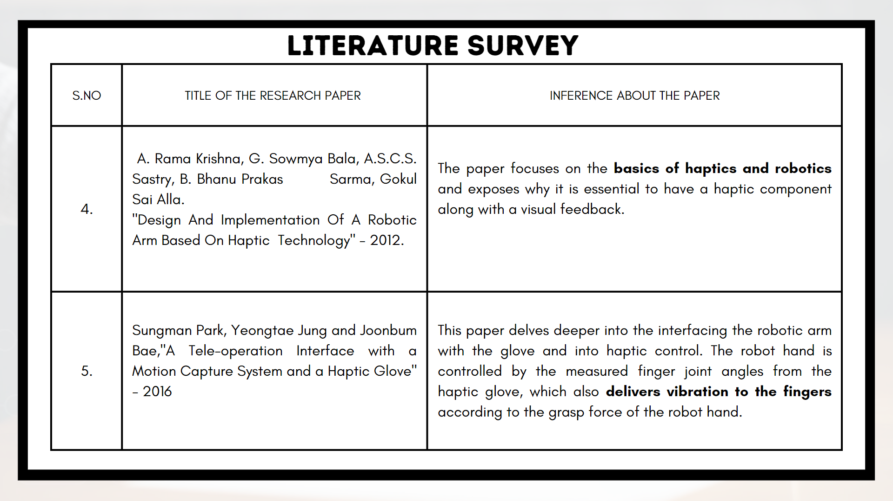
Literature survey
S.NO
4.
5.
TITLE OF THE RESEARCH PAPER
A. Rama Krishna, G. Sowmya Bala, A.S.C.S. Sastry, B. Bhanu Prakas Sarma, Gokul Sai Alla.
"Design And Implementation Of A Robotic Arm Based On Haptic Technology" - 2012.
Sungman Park, Yeongtae Jung and Joonbum Bae,"A Tele-operation Interface with a Motion Capture System and a Haptic Glove"
- 2016
INFERENCE ABOUT THE PAPER
The paper focuses on the basics of haptics and robotics and exposes why it is essential to have a haptic component along with a visual feedback.
This paper delves deeper into the interfacing the robotic arm with the glove and into haptic control. The robot hand is controlled by the measured finger joint angles from the haptic glove, which also delivers vibration to the fingers according to the grasp force of the robot hand.

Slide 9
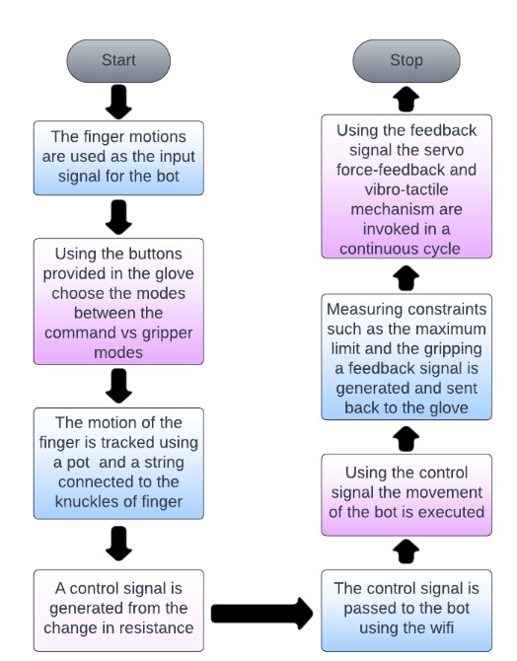
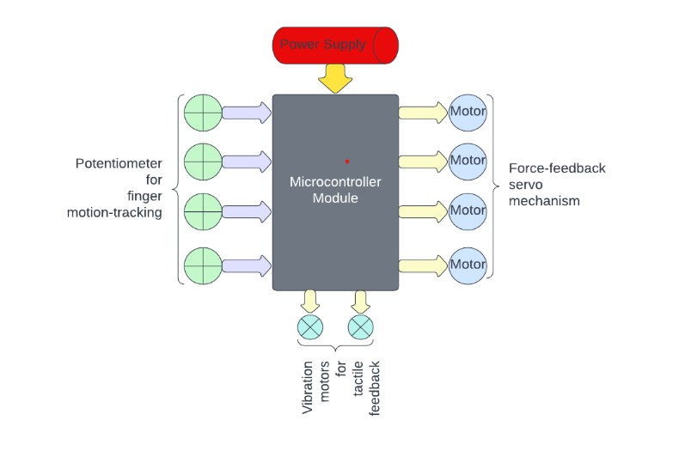
FLOW CHART
BLOCK DIAGRAM

Slide 10
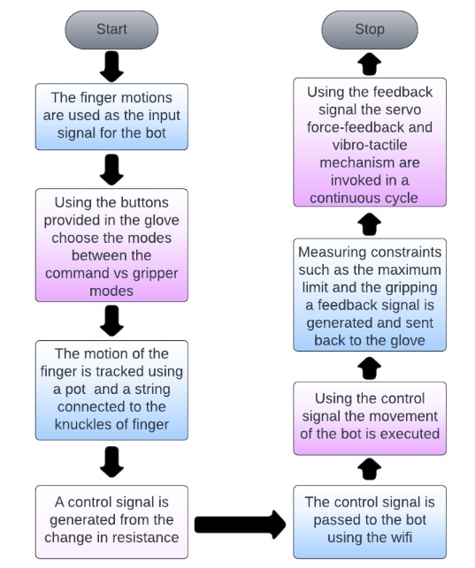
METHODOLOGY
Methodology/flowchart
The haptic glove controller module for the teleoperation of a robot is working on the following processes
First process starts with the tracking of the motion of the fingers. The tip of the fingers is connected with the potentiometer in the back of the hand using a string.
The respective voltage change is measured and the value is converted into a value of desired type of value. The generated value is passed as a control signal to the robot using the wifi module.
When each control signal is passed an appropriate feedback signal is generated based on some constraints in the robot such as the maximum movement of a particular axis or the change in the amount of torque produced by the servos present in the robot.
That feedback signal is sent back to the controller module through which the servo mechanism for the force-feedback production is produced, which makes the control of the robot movement easy.

Slide 11
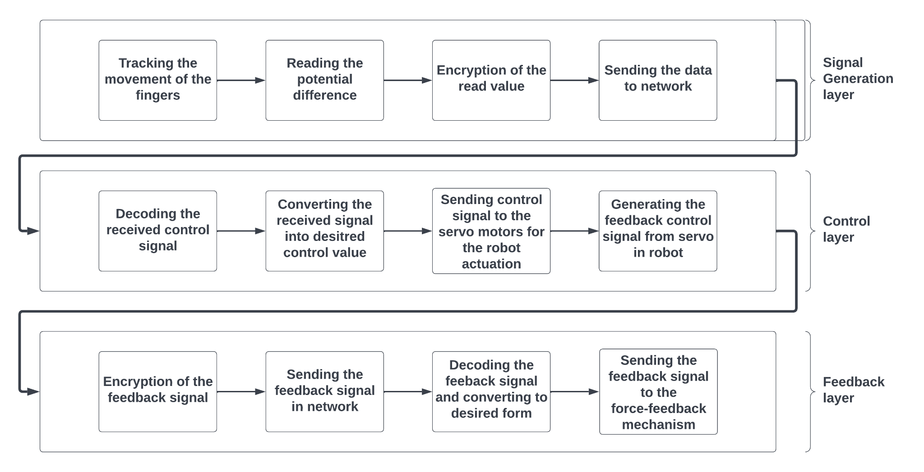
FLOW CHART
Methodology/flowchart

Slide 12
METHODOLOGY
Methodology/flowchart
Signal Generation Layer:
The first step is to track the motion of the finger to generate the control signal for the teleoperation.
The movement of the finger is to be calculated as a potential difference using the potentiometer fixed in the haptic spool mechanism for coiled retraction of the potentiometer to get the potentiometer to the initial position.
Once the required potential difference is acquired, the value of change in potential difference is encrypted to a send the data through the network as a control signal.

Slide 13
METHODOLOGY
Methodology/flowchart
Control Layer:
The signals received from the network is initially in the encrypted form, the data needs to be decoded to the desired format.
The converted data has to be send to the appropriate servo motor as a control signal.
Observing the motors movement and generating the feedback signal has to be done.
The signal generated is sent back to the controller after encrypting the signal data.
Feedback Layer:
The feedback signals received from the network is initially in the encrypted form, the data needs to be decoded to the desired format.
The data is used to control the servo motor in the force feedback mechanism to generate appropriate feedback action.

Slide 14
WORKING PRINCIPLE
Methodology/flowchart
The device has two modes that can be switched using buttons on the glove.
Command Mode
Gripper Mode
A feedback signal is generated after each control signal is sent back to the glove. The force-feedback mechanism present in the glove is activated based on the feedback signal received.
Servo mechanism embedded in a haptic glove worn by the user are used to provide force-feedback.
Combining the position and force feedback allows the user to experience a realistic sense of touch and control the serial manipulator with greater precision and accuracy.

Slide 15
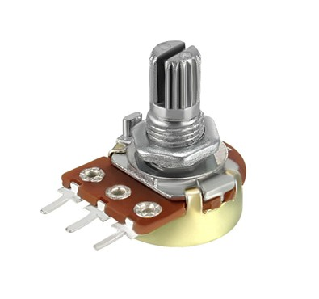
COMPONENTS USED IN THIS DEVICE
2.POTENTIOMETER
Methodology/flowchart
1.ESP32 DevKitC Board
The ESP32 DevKitC is a compact and cost-effective development board designed for developing IoT applications. It is powered by the ESP32 microcontroller unit, which is a low-power system-on- chip that combines advanced security features, Wi-Fi, and Bluetooth connectivity, digital and analog input/output interfaces, and several sensors, including an accelerometer and a temperature sensor.
A 10k rotary potentiometer is an electronic component utilized to regulate resistance in an electrical circuit.

Slide 16
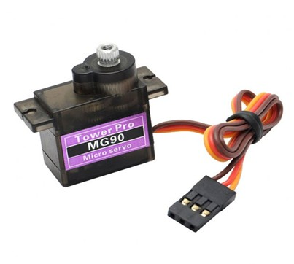
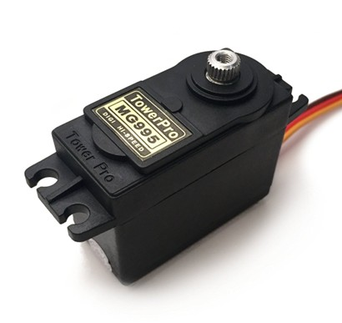
3.MG90S micro servo motor
4. MG995 servo motor
Methodology/flowchart
The MG90S servo motor is a popular choice for robotics and other applications that require precise motion control.
The MG995 servo motor is a widely used motor in applications requiring precise motion control, such as robotics.

Slide 17

5. Framework using PLA
Methodology/flowchart
PLA, or polylactic acid, is a type of biodegradable thermoplastic made from renewable resources such as corn starch, tapioca roots, or sugarcane. It is a popular material used in 3D printing due to its eco-friendliness, ease of use, and versatility.
Shell: The shell is the outermost layer of the glove that provides protection and support. It can be 3D printed using materials such as thermoplastics, nylon, or ABS. Here it is printed using PLA.
Finger caps: Finger caps are individual caps that cover the fingers of the glove. They can be 3D printed using flexible materials such as PLA to provide a comfortable fit and allow for finger movement.

Slide 18
Methodology/flowchart
8. Wrist support: The wrist support is a part of the glove that wraps around the wrist and provides support for the hand. It can be 3D printed using materials such as thermoplastics or flexible materials.
9. Potentiometer mount: A potentiometer is an electrical component that measures the position of the fingers and translates them into a control signal. The mount for the potentiometer can be 3D printed using materials such as thermoplastics to securely attach it to the glove.
10. Housing for electronic components: The electronic components of the glove, including the potentiometer and, is housed in a 3D printed component to protect them from damage.

Slide 19
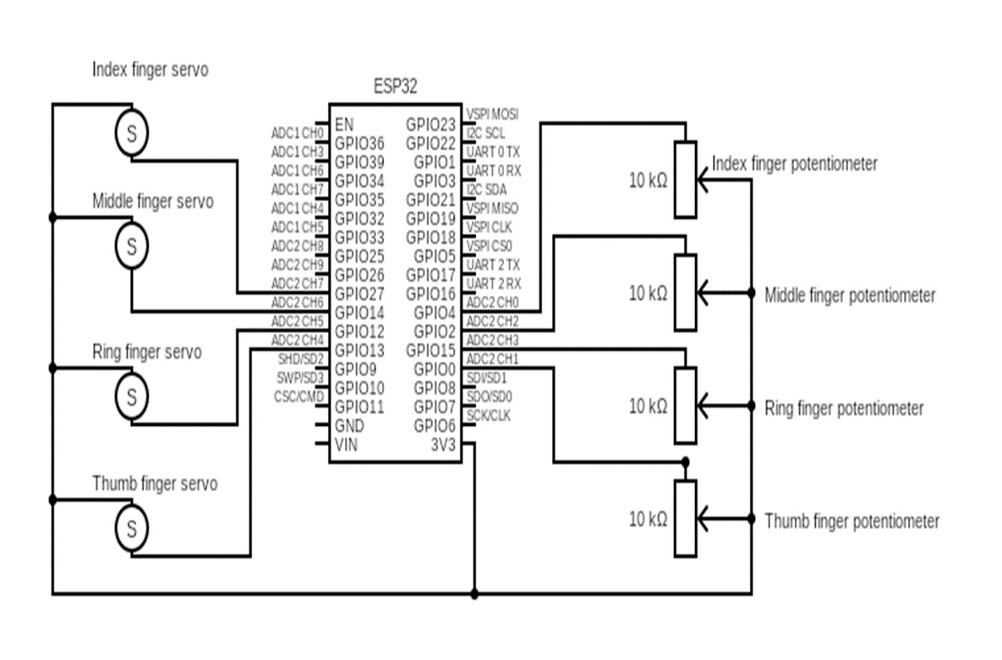
GLOVE CIRCUIT DIAGRAM

Slide 20
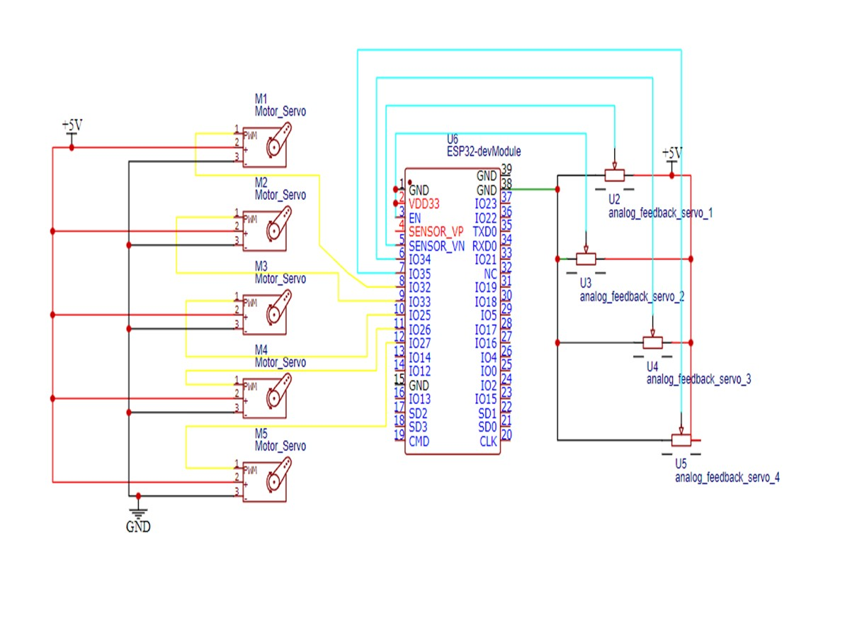
ROBOT CIRCUIT DIAGRAM

Slide 21
CALCULATIONS
10KΩ vs 50KΩ Pot
Vout = (Wiper position / Total distance ) * i/p voltage (5.1) For 10kΩ pot = ( 0.1 / 10 ) * 3.3 = 0.033 V
For analog output,
Digital Value for ESP32 range is 0 – 4095 bits Therefore,
( 0.033/3.3) * 4095 = 41.95 ~ 42
digital When wiper position is 0.2,
For digital output,
Digital output = (0.066/3.3) * 4095 = 81.9 ~ 82 digital
Therefore, every 0.1 increase in wiper position has 40 digital difference.
So in a 50kΩ pot,
Vout = (0.1/50) * 3.3 = 0.0066 V
Vout = (0.0066/3.3) * 4095 = 8.19 ~ 9 V
and,
Vout = (0.2/50) * 3.3 = 0.0132 V
Vout = (0.0132/3.3) * 4095 = 16.38 ~ 17 V
17 – 9 = 8 diff
Therefore, it is cocncluded that the 10KΩ is more sensitive than the 50KΩ pot.
We prefer to use a 10KΩ pot for it is easier to control and provide a wide range of motion compared to the 50KΩ pot. It is also typically less expensive to use a 10KΩ. It also much more compatible compared to the 50KΩ pot.

Slide 22
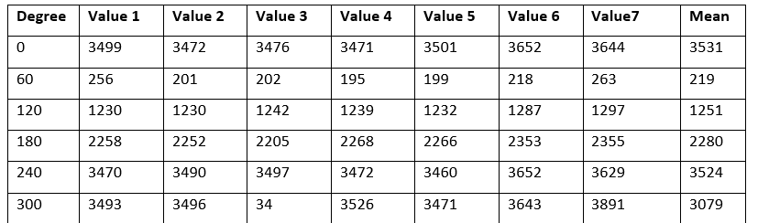
CALCULATIONS
Degree stands for the degree of rotation that will be allowed by the movement of fingers through the spool and tensioner , that will ultimately affect the potentiometer values. The above table is a variety of readings taken by us to determine the mean value.
The mean is calculated as the average of all the values for that specific degree.
Your paragraph text

Slide 23
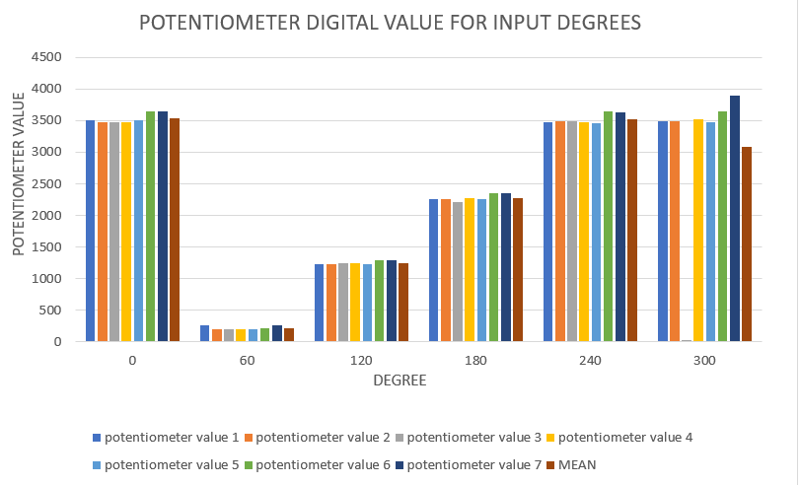
GRAPH FOR CALCULATIONS

Slide 24
CALCULATIONS
Calculation of the pot degree values:
Degree calculation based on potentiometer input value
servoAngle_degree = (180 / potentiometer_val_final - potentiometer_val_initial) *
(potentiometer_val_present-potentiometer_val_initial));
( 180 / 4095 - 300 ) * ( 806 - 300 )
servoAngle_degree = 24 degree
This value is then transmitted to the ESP32 board placed in the robot as a control signal for changing the position of each axis in the robot

Slide 25
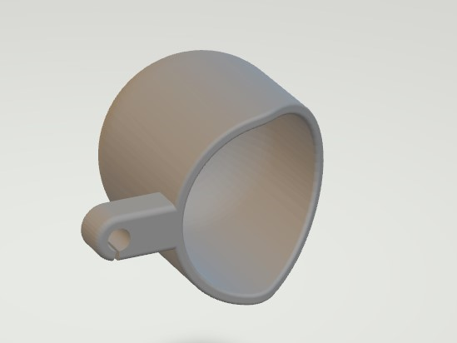


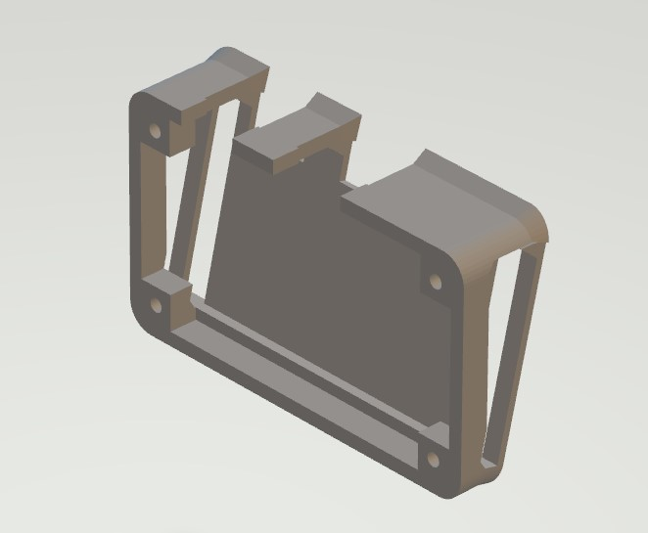
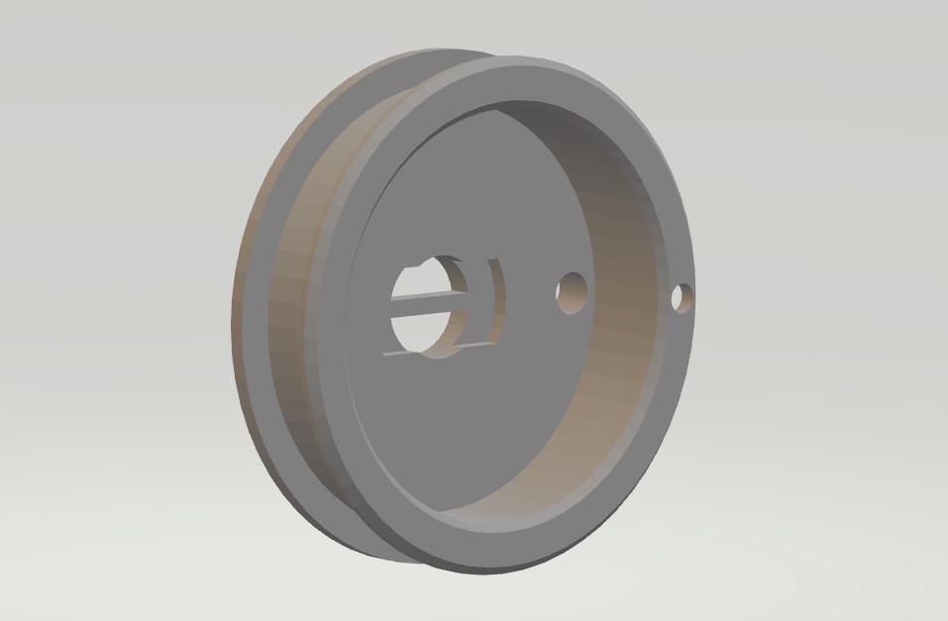
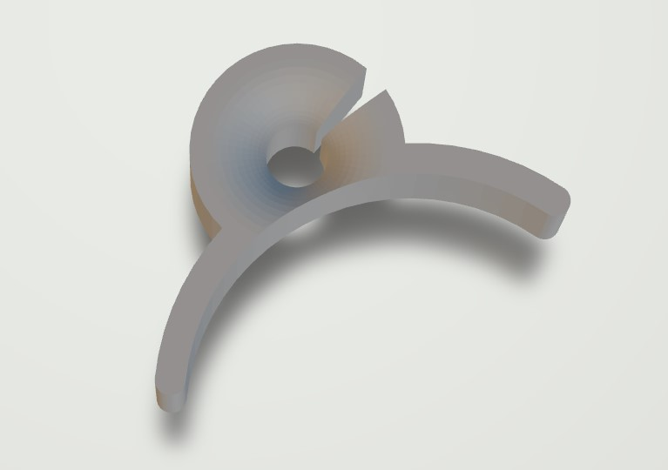
DESIGNS FOR 3D PRINTED GLOVE PARTS:
END CAPS
SPOOL COVER
TENSIONER
MICROCONTROLLER MOUNT
HAPTIC SPOOL
GUIDE NODE

Slide 26
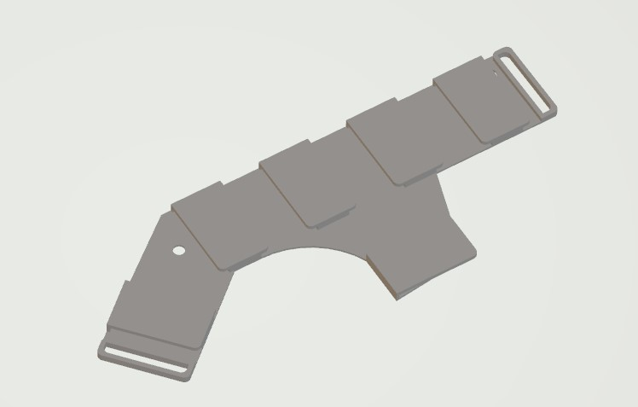
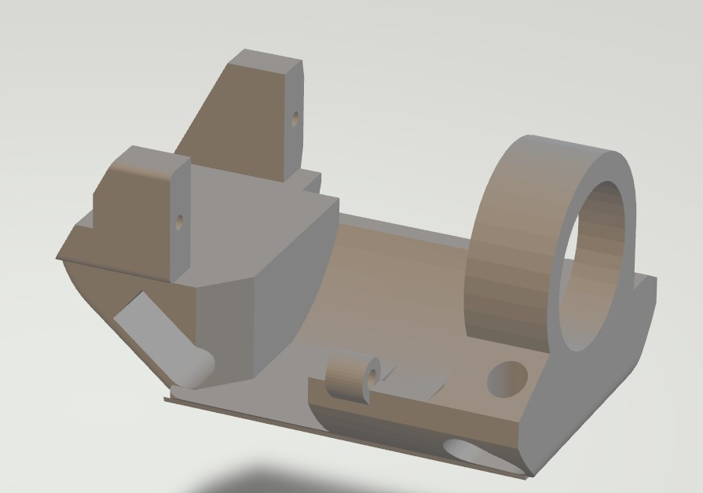
DESIGNS FOR 3D PRINTED GLOVE PARTS:
RIGID MOUNT FOR FORCE-FEEDBACK MECHANISM
MOUNT FOR FORCE-FEEDBACK MECHANISM

Slide 27
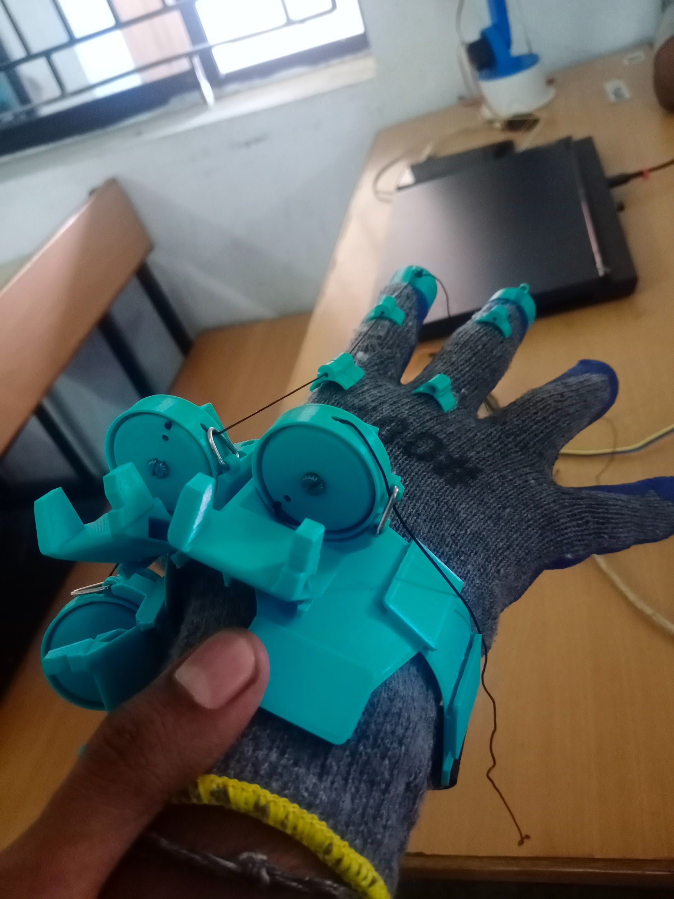
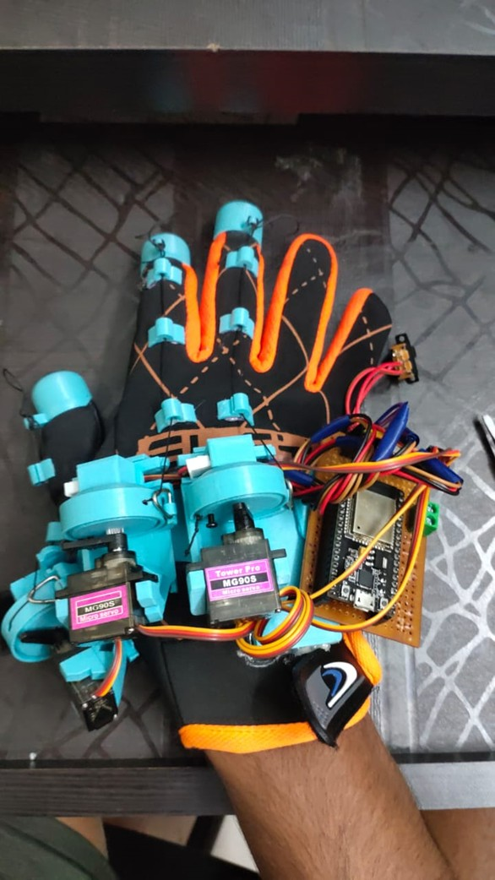
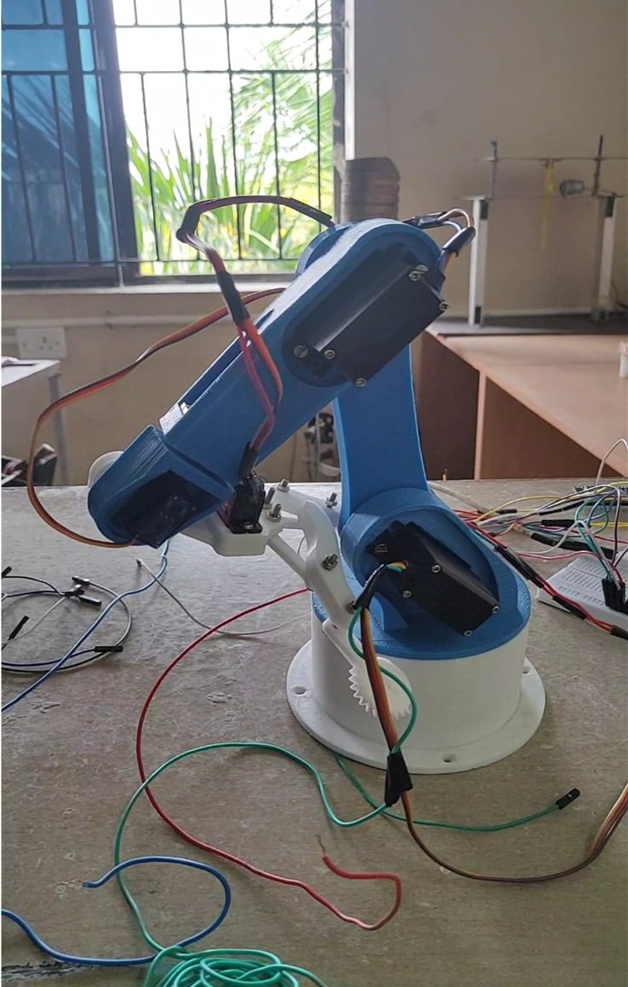
FINAL PROTOTYPE

Slide 28
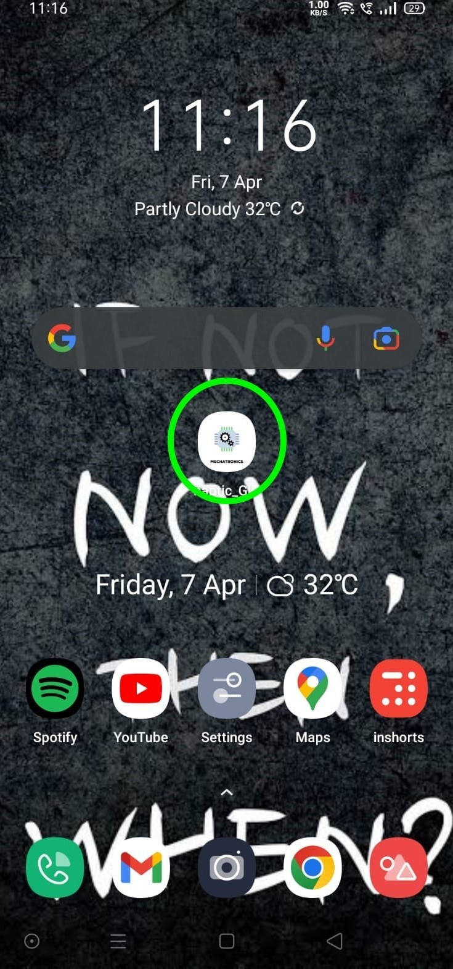
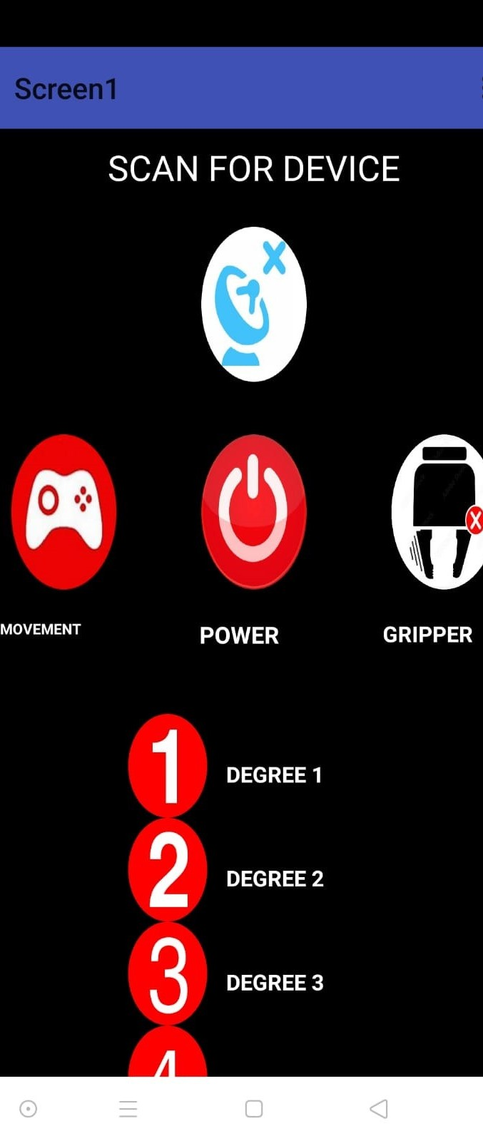
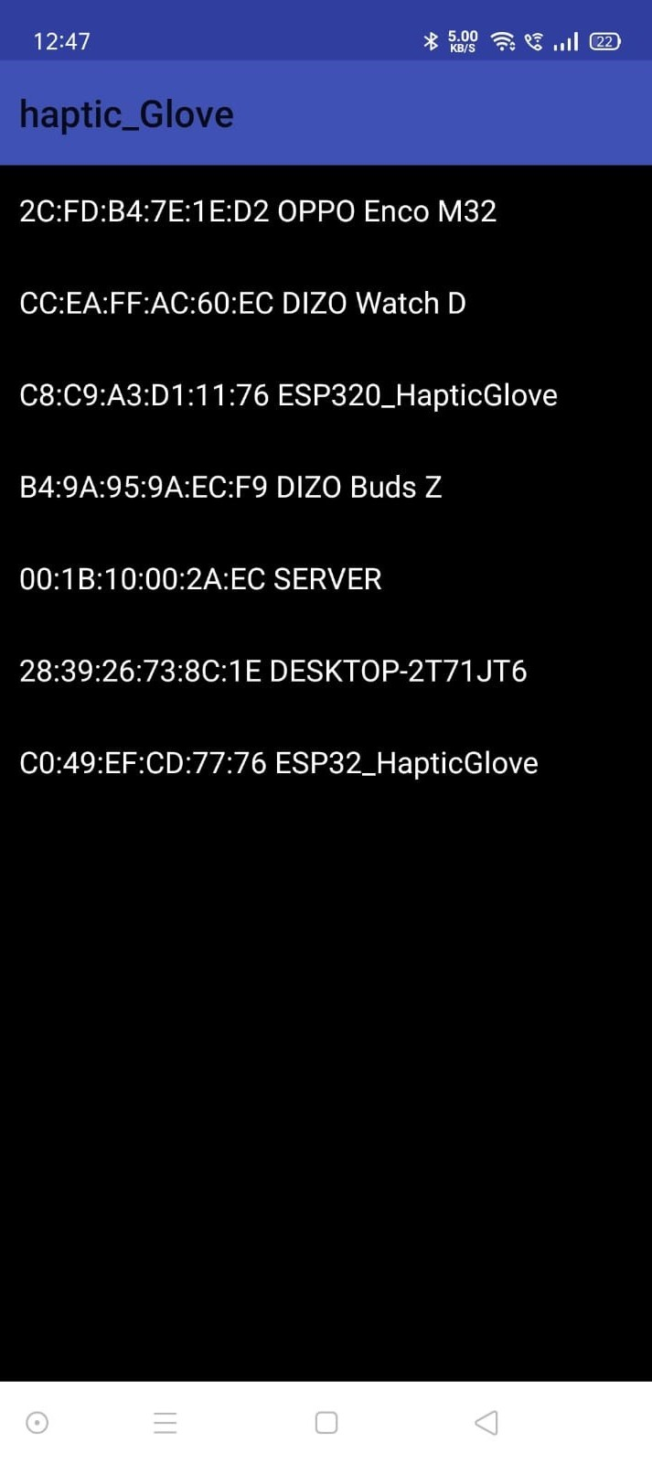
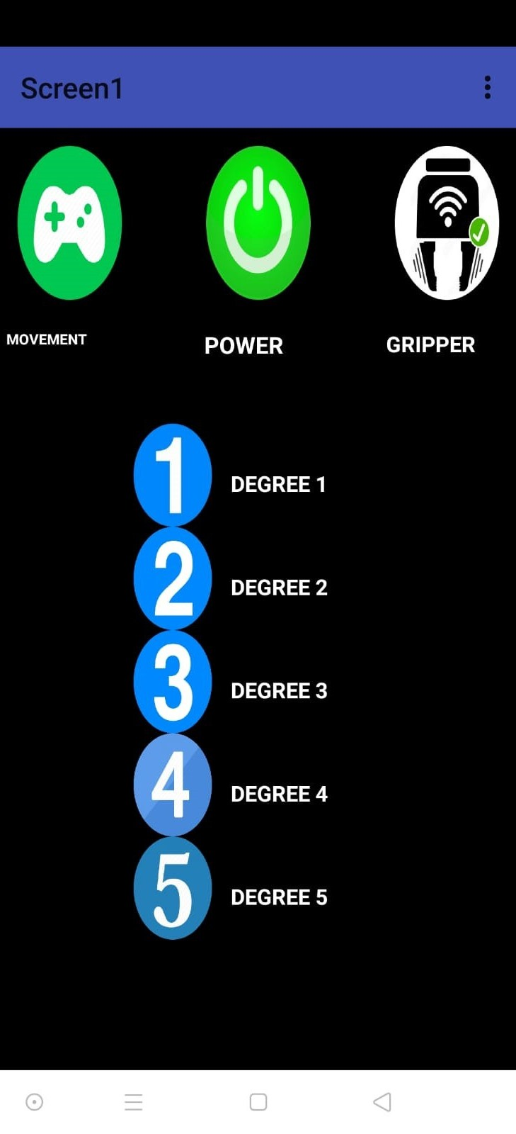
MOBILE APPLICATION INTERFACE
MOBILE APPLICATION

Slide 29
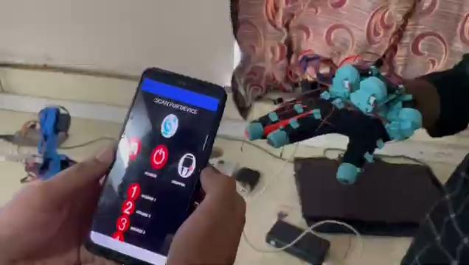
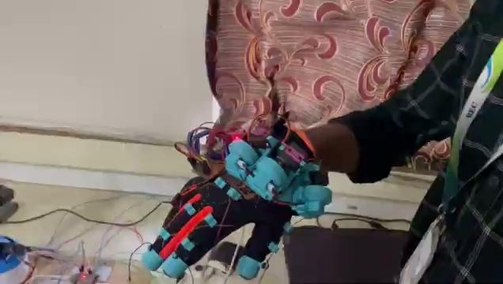
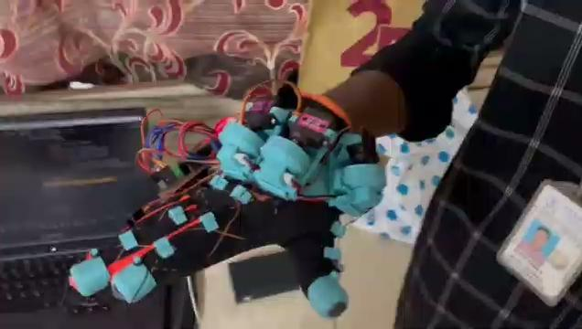
WORKING VIDEOS

Slide 30
CONCLUSION
In conclusion, the design and implementation of the haptic controller module using force-feedback has proven to be a successful endeavor.
This technology enables the user to receive tactile feedback in response to actions taken within the virtual environment, which can enhance the user's immersion and engagement in various applications such as gaming, simulation, and medical training.
The results of the testing demonstrate the effectiveness of the haptic controller module in providing an immersive and intuitive user experience.
This technology enables the user to receive tactile feedback in response to actions taken within the virtual environment, which can enhance the user's immersion and engagement in various applications such as gaming, simulation, and medical training.

Slide 31
REFERENCES
Dos Anjos, Genival Alves, Gabriel Almeida Santos, Jose A. Diaz Amado, and João Erivando Soares Marques. "Haptic glove development for passive control of a robotic arm." In 2016 IEEE XXIII International Congress on Electronics, Electrical Engineering and Computing (INTERCON), pp. 1-6. IEEE, 2016.
Dascalu, Monica, Mihail Stefan Teodorescu, Anca Plavitu, Lucian Milea, Eduard Franti, Dan Coroama, and Doina Moraru. "Tele-operated robotic arm and hand with intuitive control and haptic feedback." American Journal of Aerospace Engineering 1, no. 4 (2014): 21-27.
Gohil, Vipul J., Dr S. D. Bhagwat, Amey P. Raut, and Prateek R. Nirmal. "Robotics arm control using haptic technology." International Journal of Latest Research in Science and Technology 2, no. 2 (2013): 98-102.
Krishna, R., G. Sowmya Bala, S. Sastry ASC, B. Bhanu Prakash Sarma, and Gokul Sai Alla. "Design and implementation of a robotic arm based on haptic technology." Int. J. of Eng. Research and Applications 2, no. 34 (2012).

Slide 32
Park, Sungman, Yeongtae Jung, and Joonbum Bae. "A tele-operation interface with a motion capture system and a haptic glove." In 2016 13th International Conference on Ubiquitous Robots and Ambient Intelligence (URAI), pp. 544-549. IEEE, 2016.
Motamedi, M. Reza, Jean-Baptiste Chossat, Jean-Philippe Roberge, and Vincent Duchaine. "Haptic feedback for improved robotic arm control during simple grasp, slippage, and contact detection tasks." In 2016 IEEE International Conference on Robotics and Automation (ICRA), pp. 4894-4900. IEEE, 2016.
Chen, C. J., S. K. Ong, A. Y. C. Nee, and Y. Q. Zhou. "Haptic-based interactive path planning for a virtual robot arm." International Journal on Interactive Design and Manufacturing (IJIDeM) 4, no. 2 (2010): 113-123.
Wilberz, Alexander, Dominik Leschtschow, Christina Trepkowski, Jens Maiero, Ernst Kruijff, and Bernhard Riecke. "Facehaptics: Robot arm based versatile facial haptics for immersive environments." In Proceedings of the 2020 CHI Conference on Human Factors in Computing Systems, pp. 1-14. 2020.

Slide 33
Bimbo, Joao, Claudio Pacchierotti, Marco Aggravi, Nikos Tsagarakis, and Domenico Prattichizzo. "Teleoperation in cluttered environments using wearable haptic feedback." In 2017 IEEE/RSJ International Conference on Intelligent Robots and Systems (IROS), pp. 3401-3408. IEEE, 2017.
González, Claudia, J. Ernesto Solanes, Adolfo Munoz, Luis Gracia, Vicent Girbés-Juan, and Josep Tornero. "Advanced teleoperation and control system for industrial robots based on augmented virtuality and haptic feedback." Journal of Manufacturing Systems 59 (2021): 283-298.
Yuan Guo, Dangxiao Wang, Senior Member, IEEE, Ziqi Wang, Xiuping Yang, Haitong Wang, Yuru Zhang, Senior Member, IEEE, Weiliang Xu, Senior Member, IEEE “Achieving High Stiffness Range of Force Feedback Gloves using Variable Stiffness Mechanism.” 2019 IEEE World Haptics Conference (WHC) Tokyo, Japan.
I. Choi, E. W. Hawkes, D. L. Christensen, C. J. Ploch, and S. Follmer, “Wolverine: A wearable haptic interface for grasping in virtual reality,” presented at the 2016 IEEE/RSJ International Conference on Intelligent Robots and Systems, Daejeon, South Korea, October 9-14, 2016, pp. 986-993.

Slide 34
Data Glove Qi Zhu, Vinicius Prado da Fonseca, Bruno Monteiro Rocha Lima, Maxwell Welyhorsky, Miriam Goubran, Thiago Eustaquio Alves de Oliveira, Emil M. Petriu. “ Teleoperated Grasping Using a Robotic Hand and a Haptic-Feedback Data Glove”
I. M. Bullock, R. R. Ma, and A. M. Dollar, “A Hand-Centric Classification of Human and Robot Dexterous Manipulation,” IEEE
“CyberGloveSystems. (2013) Cybergrasp.[Online]. Available: http://www.cyberglovesystems.com.”
Donghyun Sim, Yoonchul Baek, Minjeong Cho, Sunghoon Park, A. S. M. Sharifuzzaman Sagar, and Hyung Seok Kim. “Low-Latency Haptic Open Glove for Immersive Virtual Reality Interaction”
Mohssen Hosseini, Ali Seng ¨ul, Yudha Pane, Joris De Schutter and Herman Bruyninckx. “ExoTen-Glove: A Force-Feedback Haptic Glove Based on Twisted String Actuation System,” 27th IEEE International Symposium on Robot and Human Interactive Communication

Slide 35
G. Palli, C. Natale, C. May, C. Melchiorri, and T. W ¨urtz, “Modeling and control of the twisted string actuation system,” IEEE/ASME Trans. on Mechatronics, vol. 18, no. 2, pp. 664–673, 2013.
S. Moshe, “Twisting wire actuator,” Journal of Mechanical Design, vol. 127, no. 3, p. 441–445, jul 2004.
www.htc.com/in
Francesca Sorgini, Giuseppe Airò Farulla, Nikola Lukic, Ivan Danilov, Calogero Maria Oddo, Petar B. Petrovic, Bozica Bojovic, “Tactile sensing with gesture-controlled collaborative robot” IEEE.
Sihui Li, Raagini Rameshwar, Ann Marie Votta, and Cagdas D. Onal, “Intuitive Control of a Robotic Arm and Hand System with Pneumatic Haptic Feedback,”IEEE.
Sebastian Friston, Elias Griffith, David Swapp, Alan Marshall and Anthony Steed, “Position-Based Control of Under-Constrained Haptics: A System for the Dexmo Glove” IEE

Slide 36
Filippo Sanfilippo, Claudio Pacchierotti, “A Low-Cost Multi-Modal Auditory-Visual-Tactile Framework for Remote Touch,”IEEE
Leap Motion Inc. (2020, February) “The Leap Motion Controller”. [Online]. Available: http://www.leapmotion.com/ .
Oculus VR. (2020, February) “Oculus Rift Development Kit 2”. [Online]. Available: http://www.oculus.com/
Unity Technologies. (2020, February) “Unity3D”. [Online]. Available: http://unity3d.com/.
Zhongda Sun, Minglu Zhu, Zhaocong Chen, Xuechuan Shan, and Chengkuo Lee, “Haptic-Feedback Ring enabled Human-Machine Interface(HMI) aiming at Immersive Virtual Reality Experience,” IEEE
Y.Wang and L.Fang, “Principle andDesign of Mechanically Musculoskeletal Variable-Stiffness Mechanism,”Robot, vol. 4, pp. 506-512, Apr. 2015.(in Chinese).

Slide 37
A. Jafari, N. G. Tsagarakis and D. G. Caldwell, “AwAS-II: A new Actuator withAdjustable Stiffness basedon the novelprinciple of adaptable pivot point andvariable lever ratio,” presented at the 2011 IEEE InternationalConference on Roboticsand Automation, Shanghai, China, May 9-13, 2011, pp. 4638-4643
Z.MA and P.Ben-Tzvi, “RML Glove-anExoskeleton Glove Mechanism WithHaptics Feedback,” IEEE/ASME Transactions on Mechatronics, vol. 20, pp. 641-652, Apr. 2015
X.Gu, Y. Zhang, W. Sun, Y.Bian, D. Zhou, and P.O. Kristensson, “Dexmo: AnInexpensive and LightweightMechanical Exoskeleton for Motion Capture and Force Feedback in VR,” in Proceedings of the 2016 CHI Conference on Human Factors in Computing Systems, San Jose, 2016, pp. 1991-1995
I. Choi, E. W. Hawkes, D. L. Christensen, C. J. Ploch, and S. Follmer, “Wolverine:A wearable hapticinterface for graspingin virtual reality,” presented at the 2016 IEEE/RSJ International Conference on Intelligent Robots and Systems, Daejeon, South Korea, October 9-14, 2016, pp. 986-993

Slide 38
Thank you!

